Slide 1



Intro to GNAF
Hugh Saalmans - @minus34

Slide 2
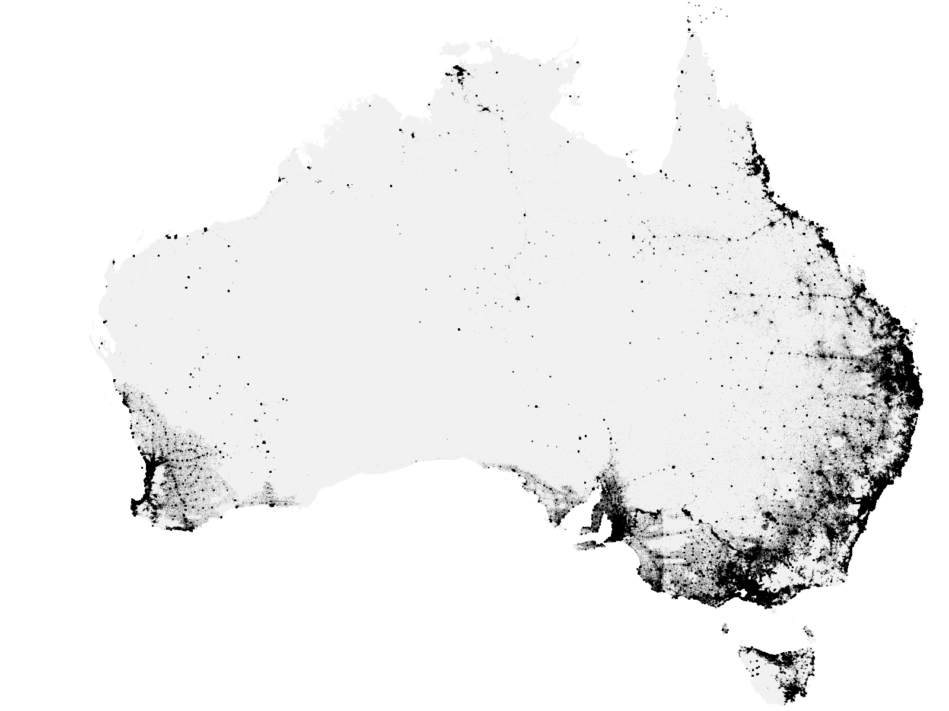
What’s GNAF?

Slide 3
A national dataset of 13m validated addresses with coordinates

Slide 4

Why is GNAF awesome?

Slide 5
It underpins decision making & economic activity…

Slide 6
…at the national level

Slide 7
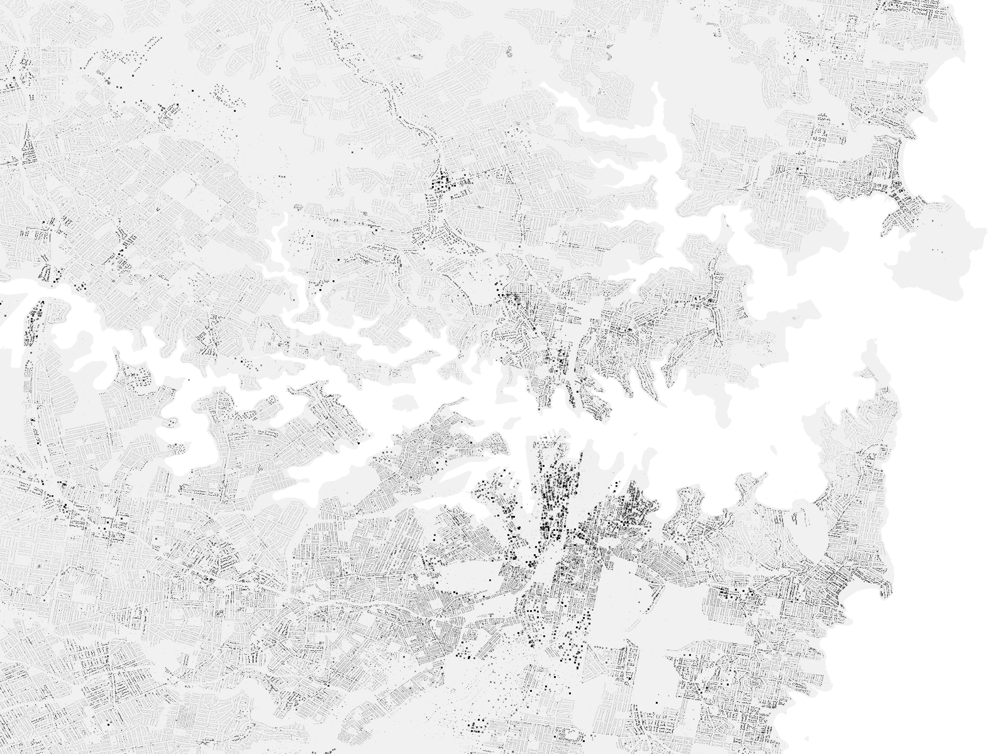
…the regional level

Slide 8
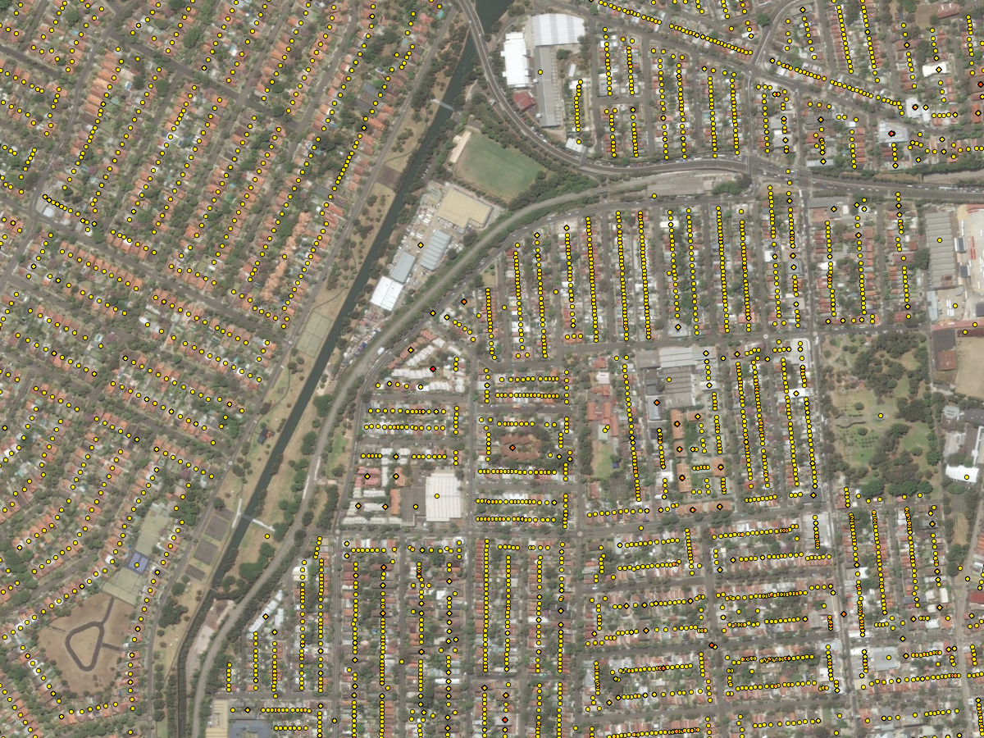
…and at a granular level

Slide 9
This week…

Slide 10

…GNAF becomes OPEN DATA!

Slide 11
Time for a deep dive!?

Slide 12
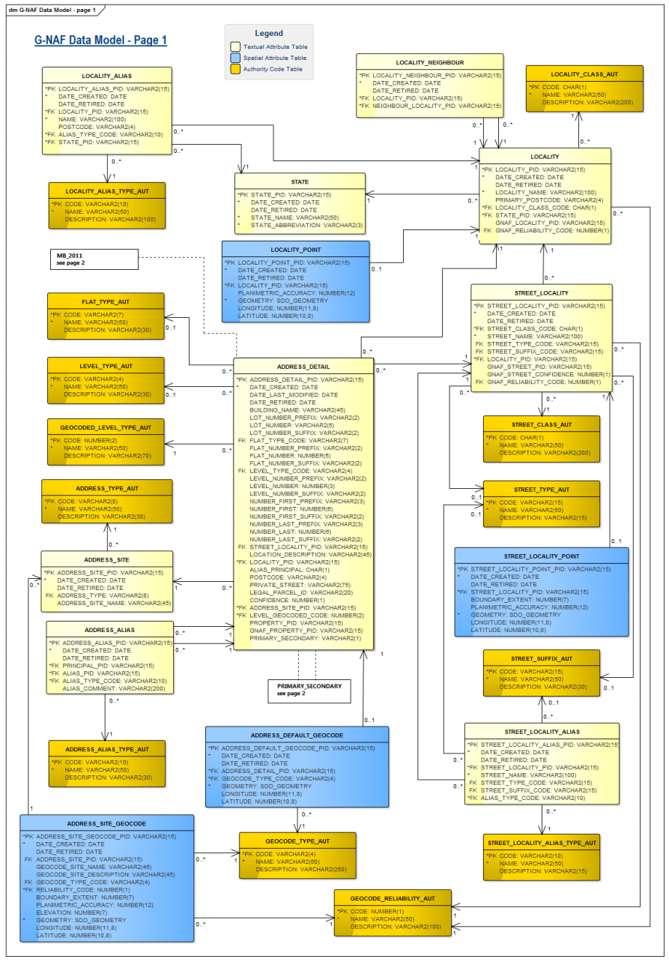
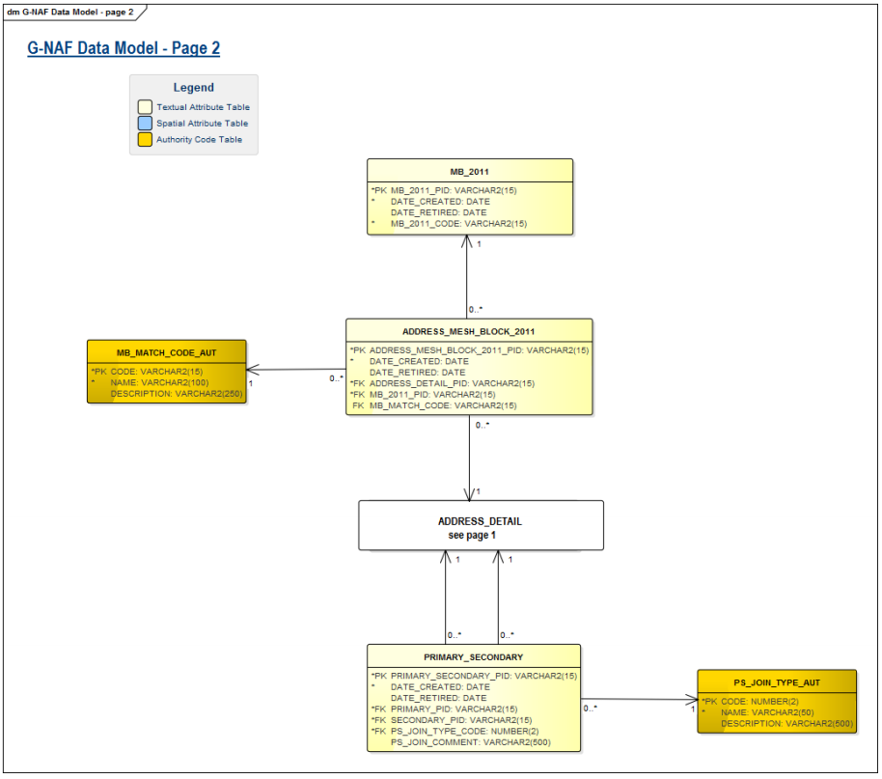
The GNAF
data model

Slide 13
4.8 Gb
144 PSV files
31 tables
39 foreign keys

Slide 14


Slide 15
Let’s
Simplify
things…

Slide 16
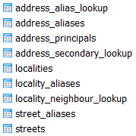

Slide 17

Introducing… gnaf-loader!

Slide 18
Let‘s get started

Slide 19

Step 1: download the data

Slide 20




Step 2: install the pre-reqs
+
+
(Psycopg2)

Slide 21

Step 3: run the code*
https://github.com/minus34/gnaf-loader
* Postgres dump & PSV files coming soon

Slide 22
Step 4: learn GNAF...
ADDRESSES
STREETS
LOCALITIES

Slide 23
ADDRESSES (13m)
Keyed by gnaf_pid
Represent an address validated by
State Govt, Australia Post and/or the AEC
Must link to a street and locality
(via locality_pid & street_locality_pid)
Can be a principal address (20 FRED ST) or an alias/duplicate (20-30 FRED ST)
Can be a primary address (10 JOHN ST) or secondary address (Unit 2, 10 JOHN ST)
95% have coordinates inside the property
Link to the ABS Census (mb_2011_code) and property information (legal_parcel_id)

Slide 24
STREETS (700k)
Keyed by street_locality_pid
Represent a unique street name in a locality
i.e. Pacific Hwy, Chatswood
!= to Pacific Hwy, Artarmon
Must link to a locality (via locality_pid)
Can have an alias name
(Main St = Hume Hwy)

Slide 25
LOCALITIES (16k)
Keyed by locality_pid
Represent suburbs, towns, localities and topographic features
Can have an alias name
(CITY, ACT = CANBERRA, ACT)
Are surrounded by neighbouring localities

Slide 26
Thanks, enjoy! BTW…

Slide 27
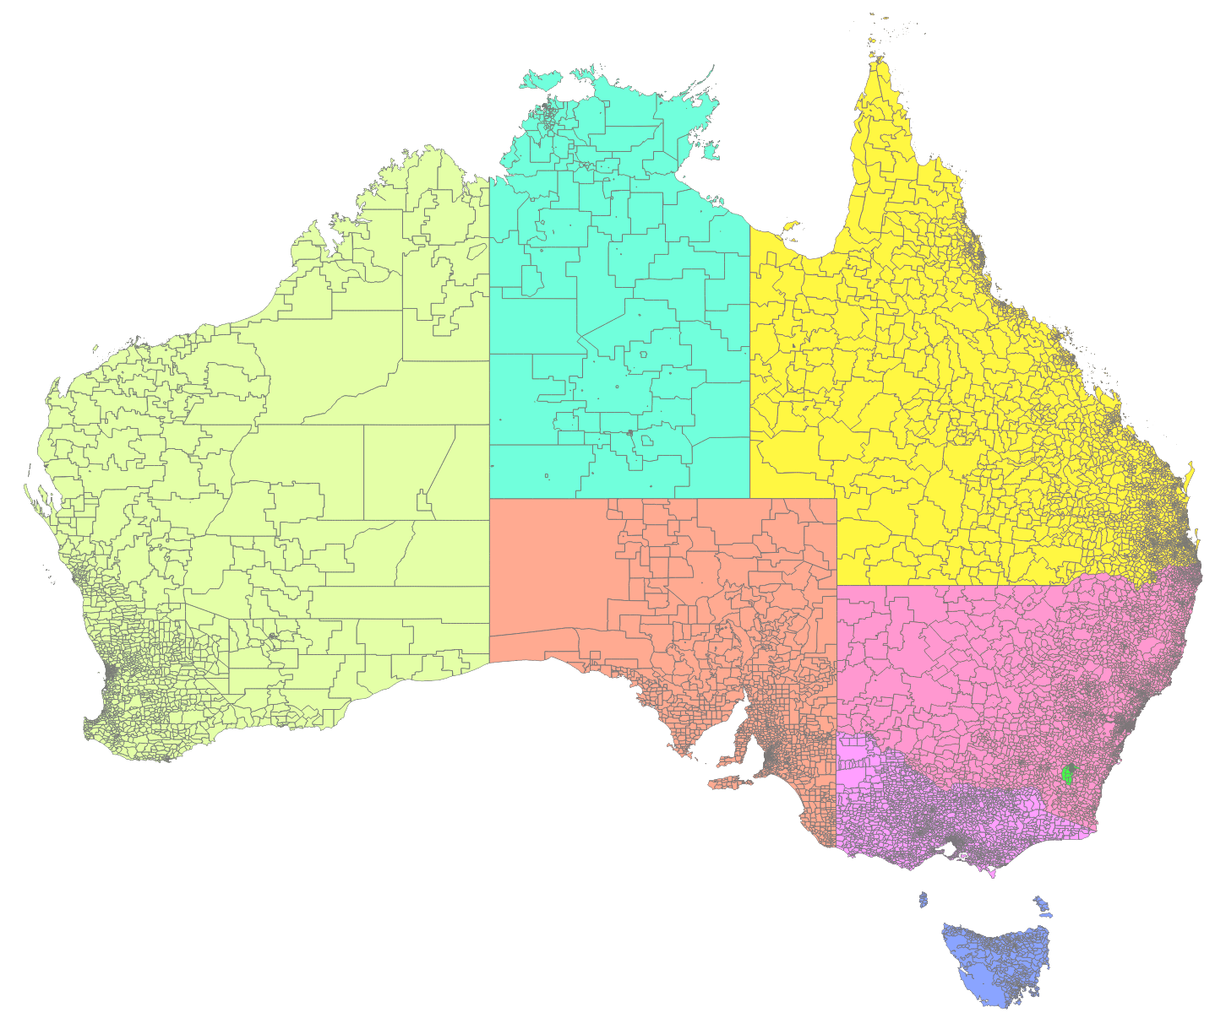
There’s the Admin Bdys as well!

